Slide 1
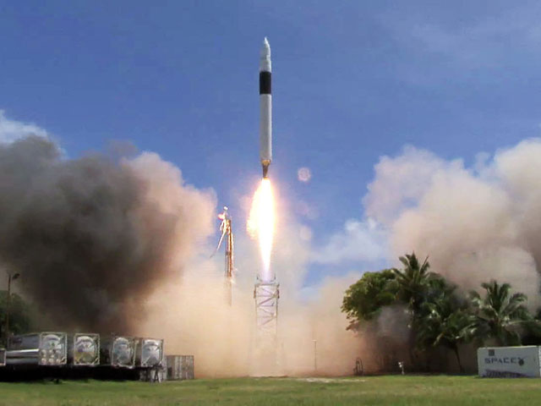
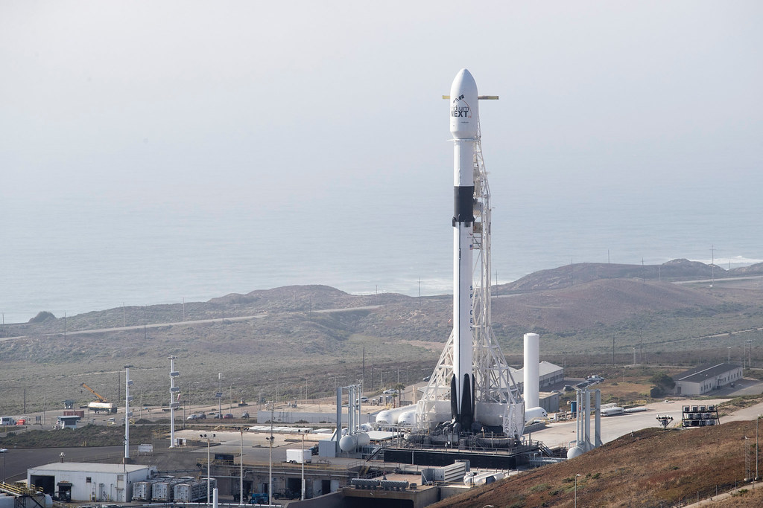
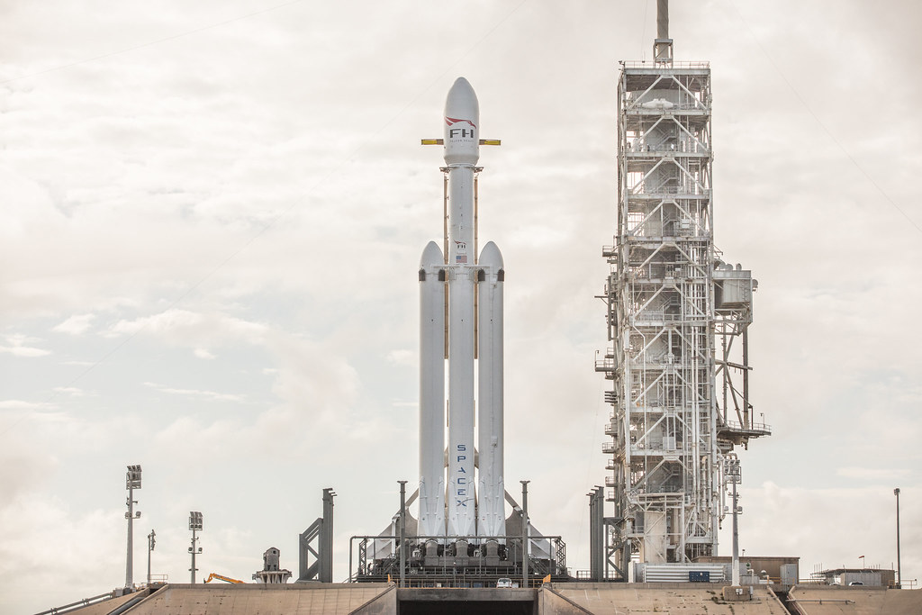
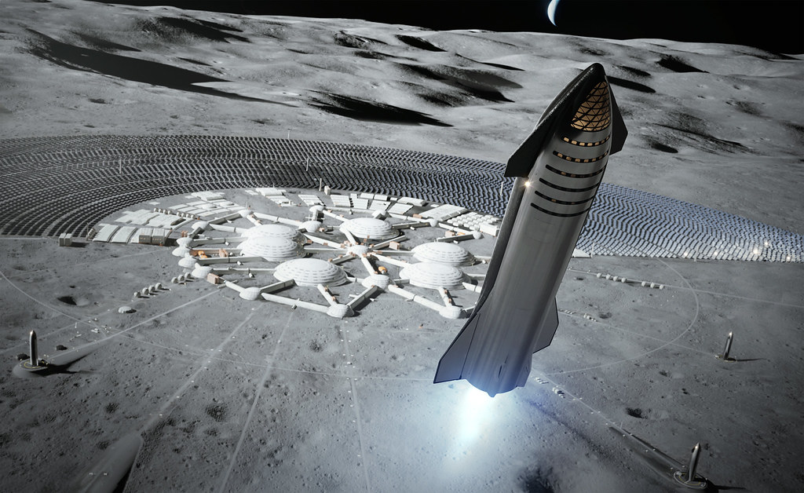
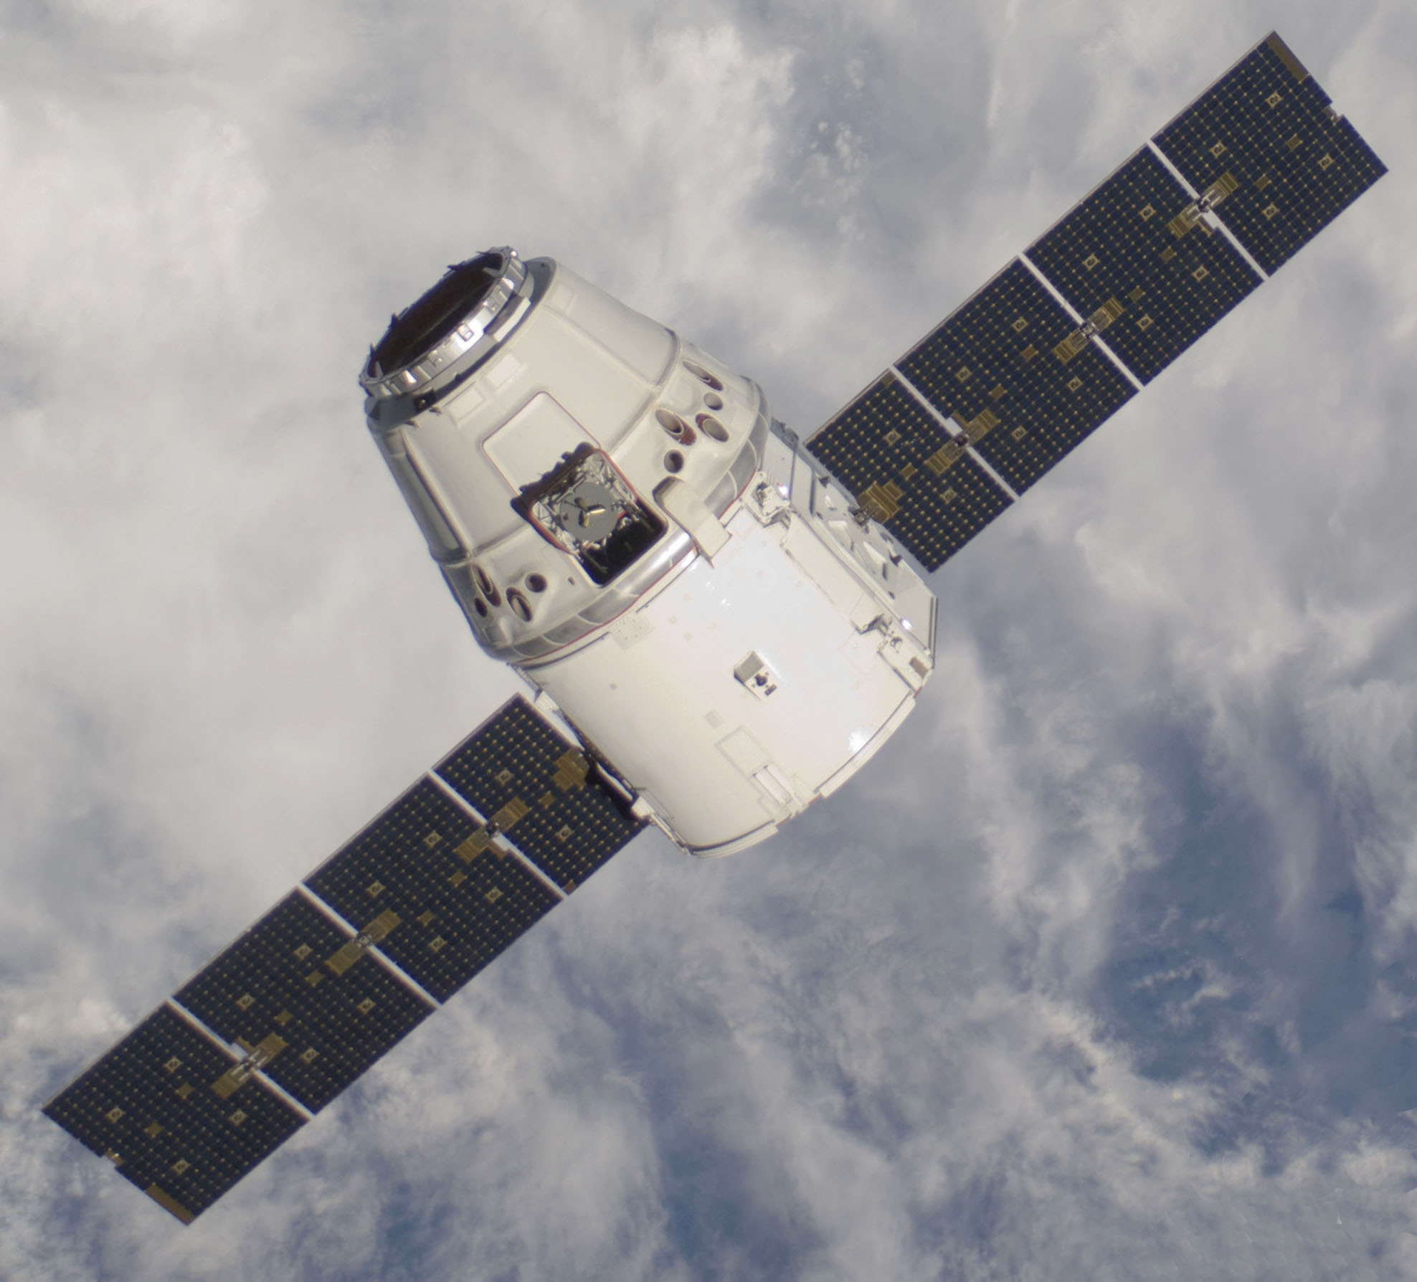
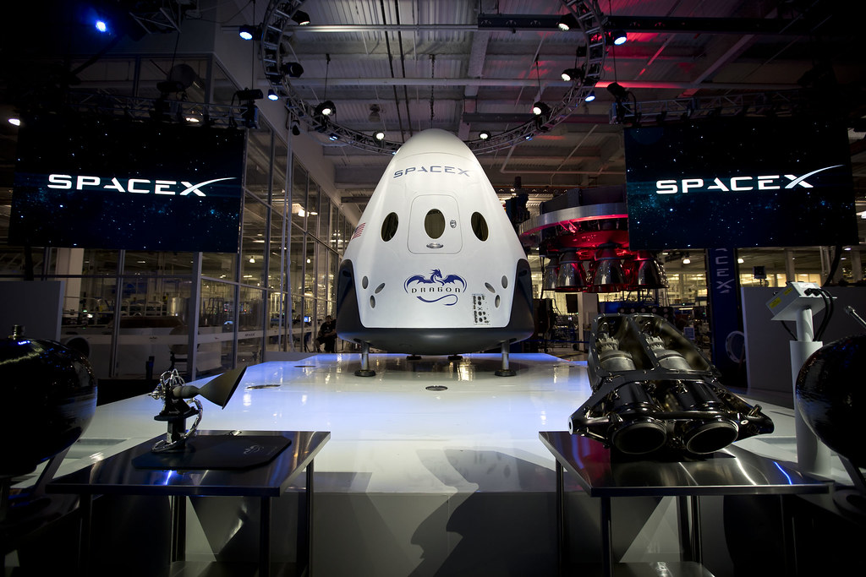
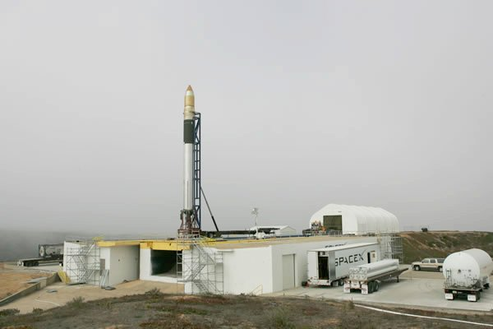
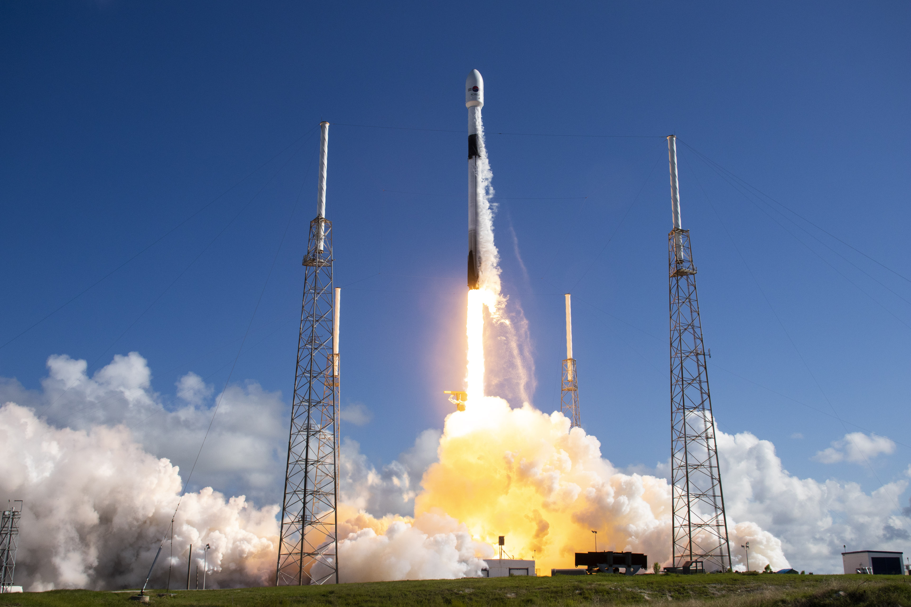
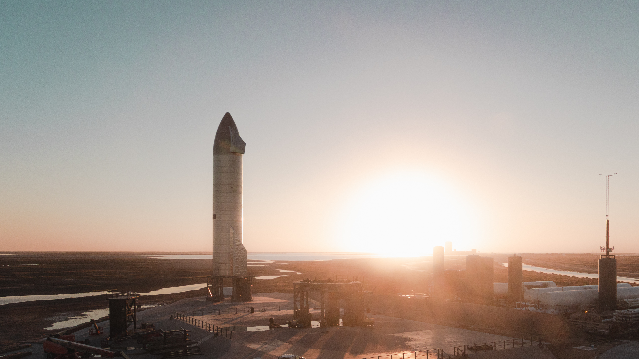
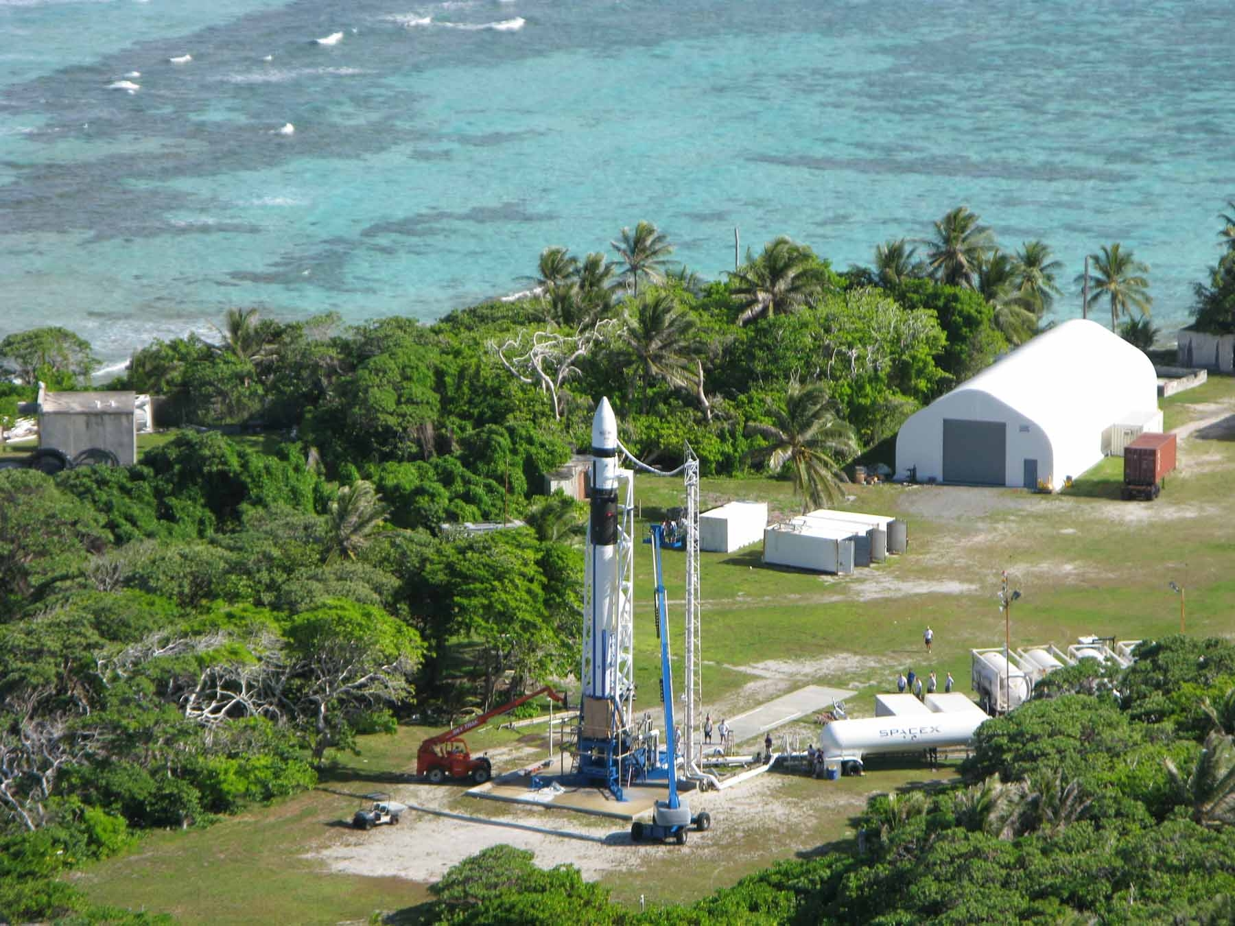
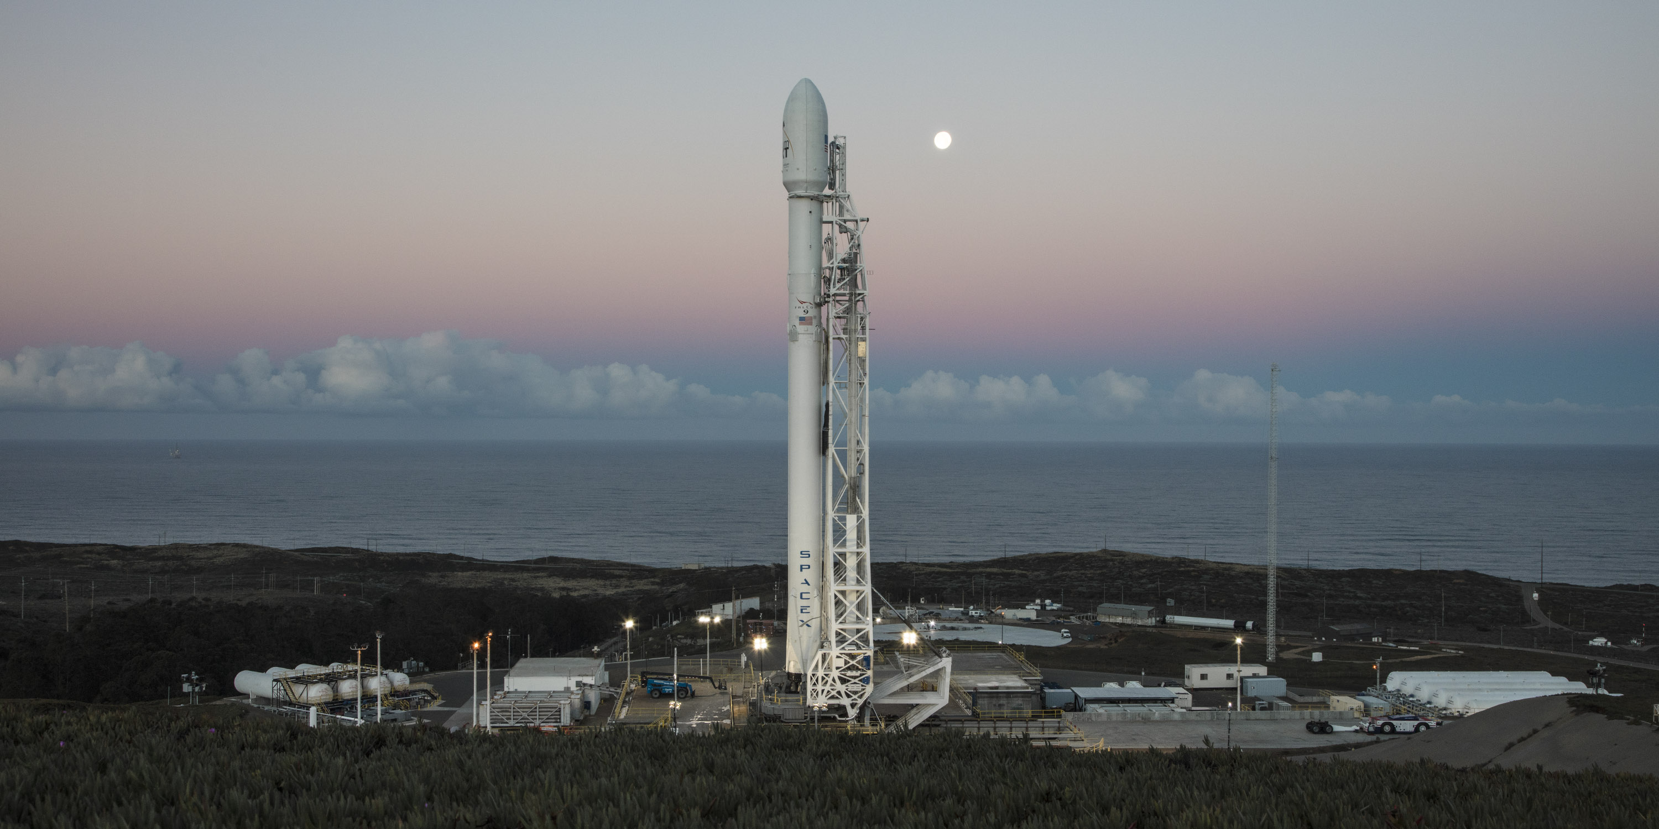
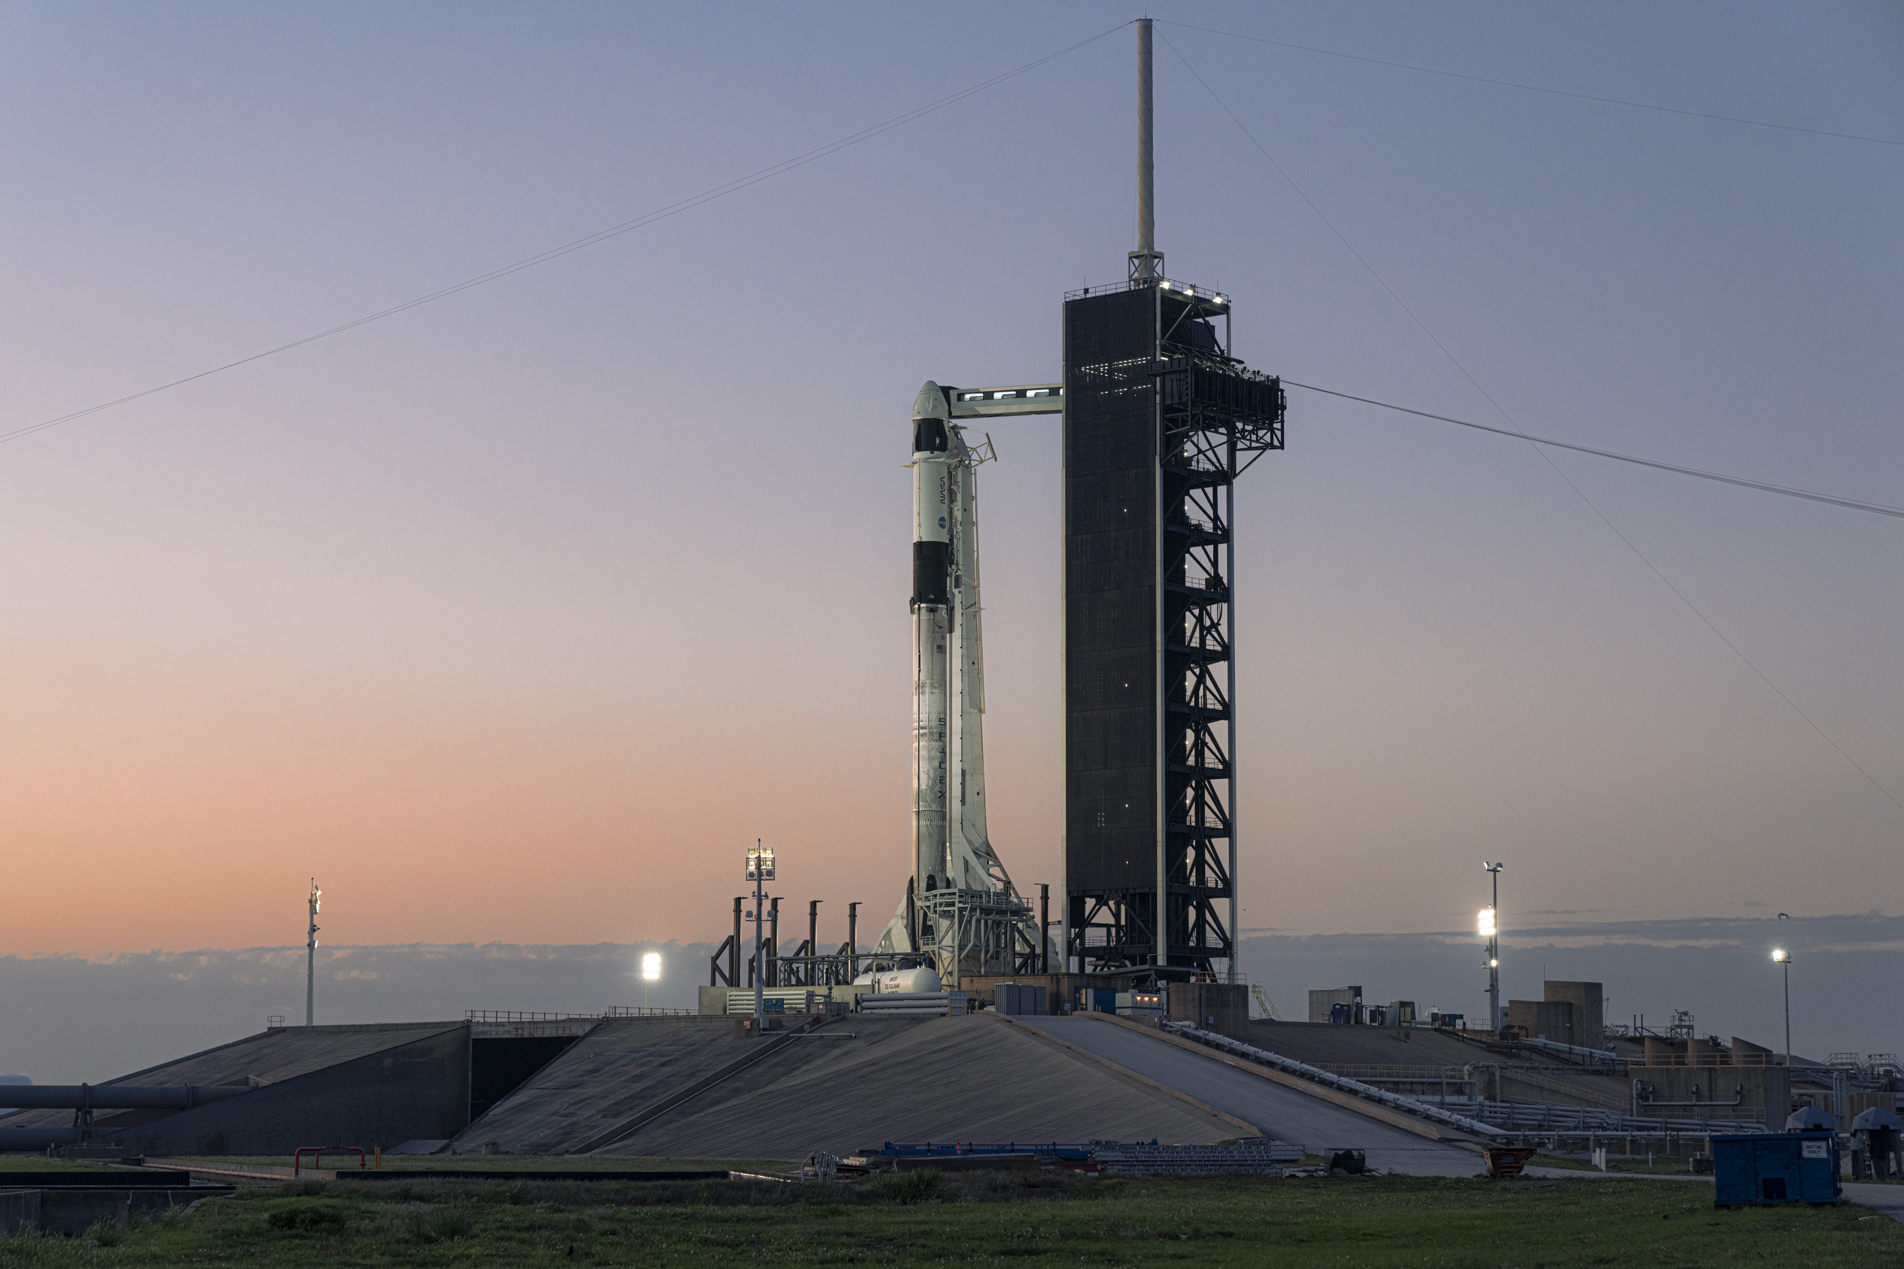
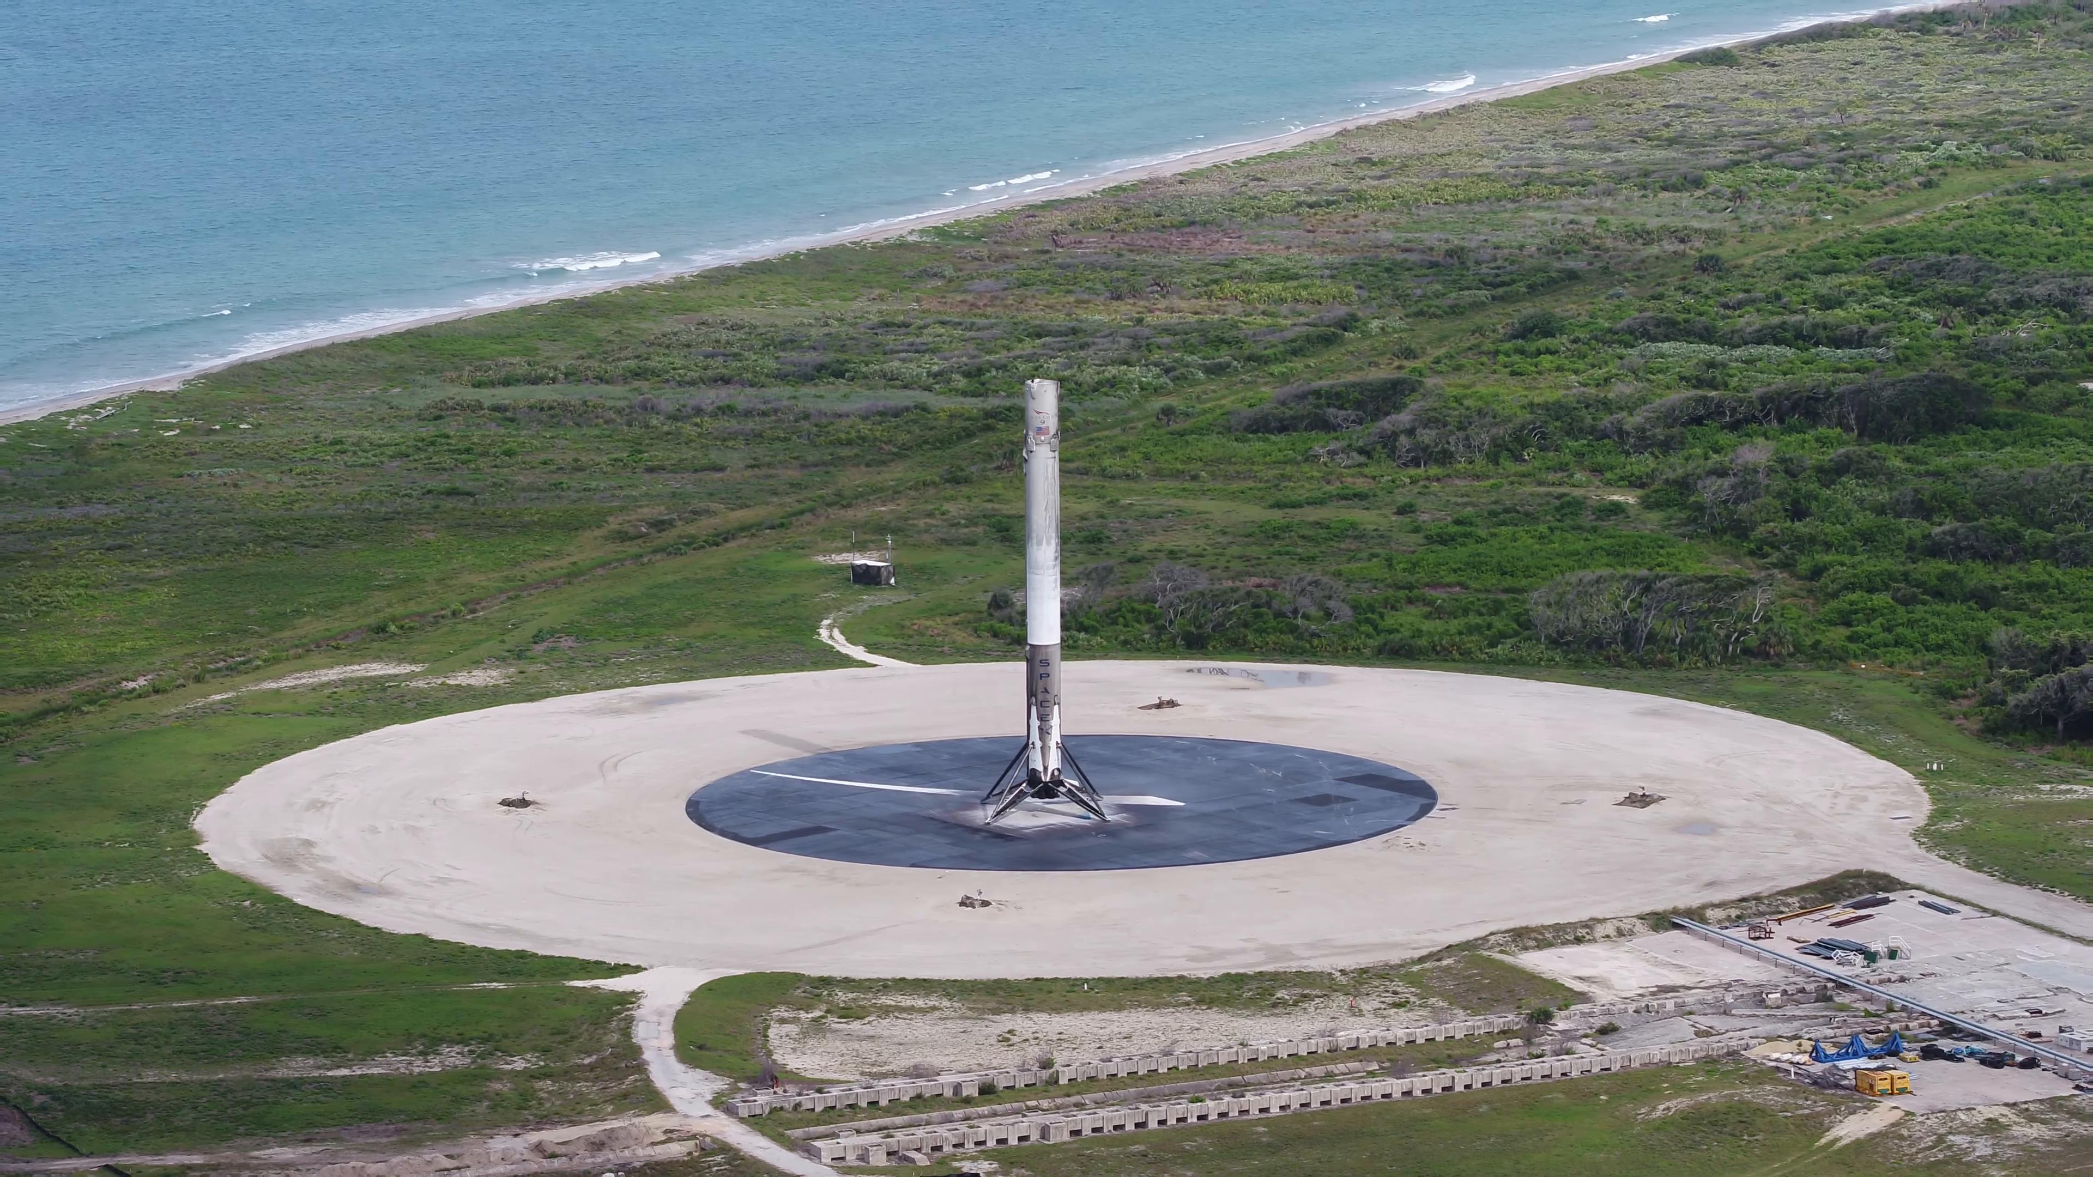
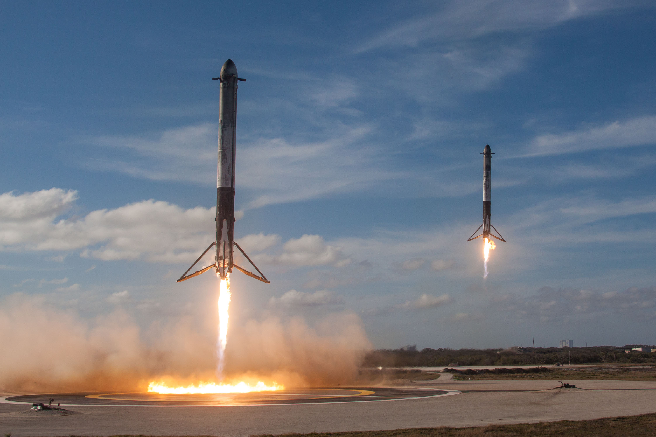
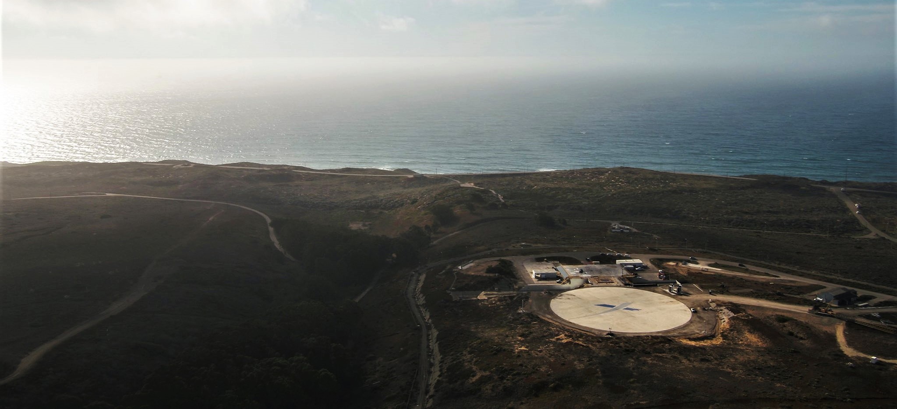
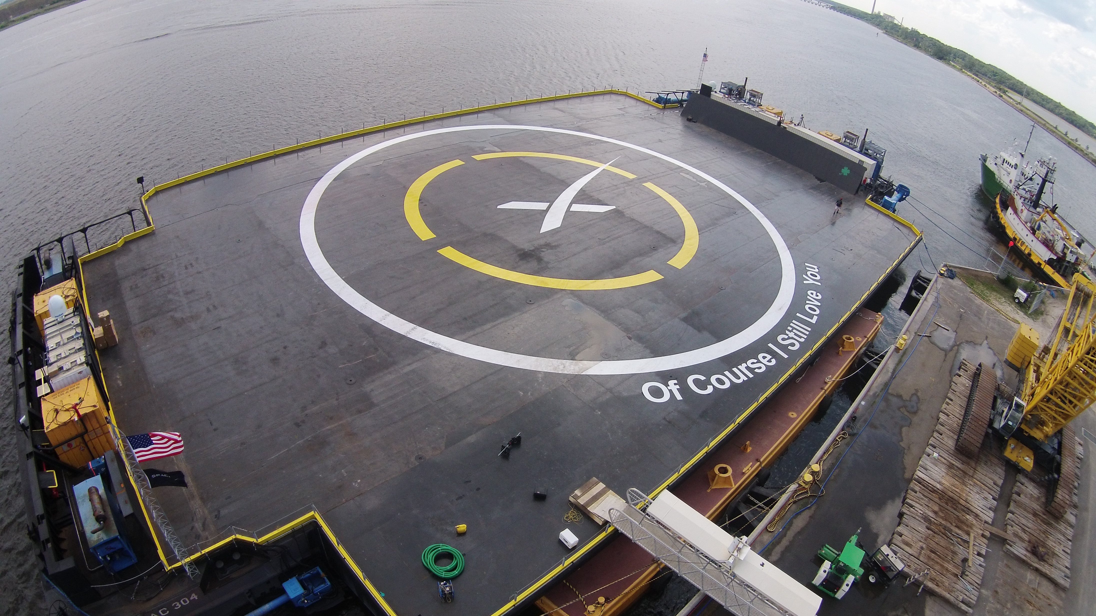
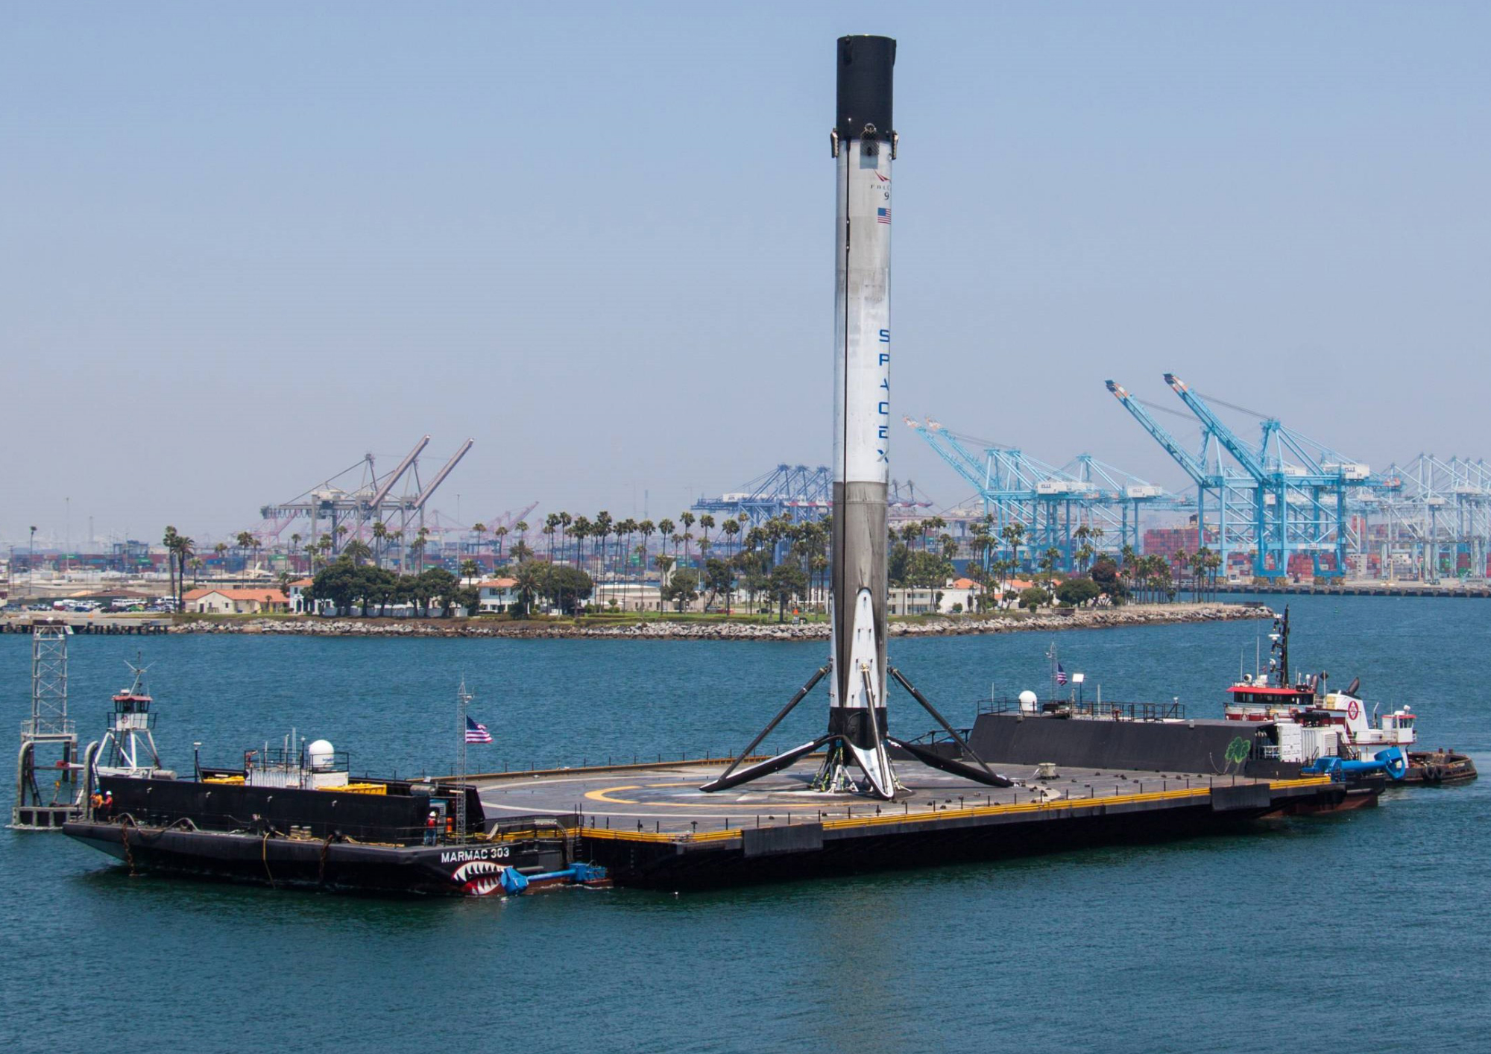
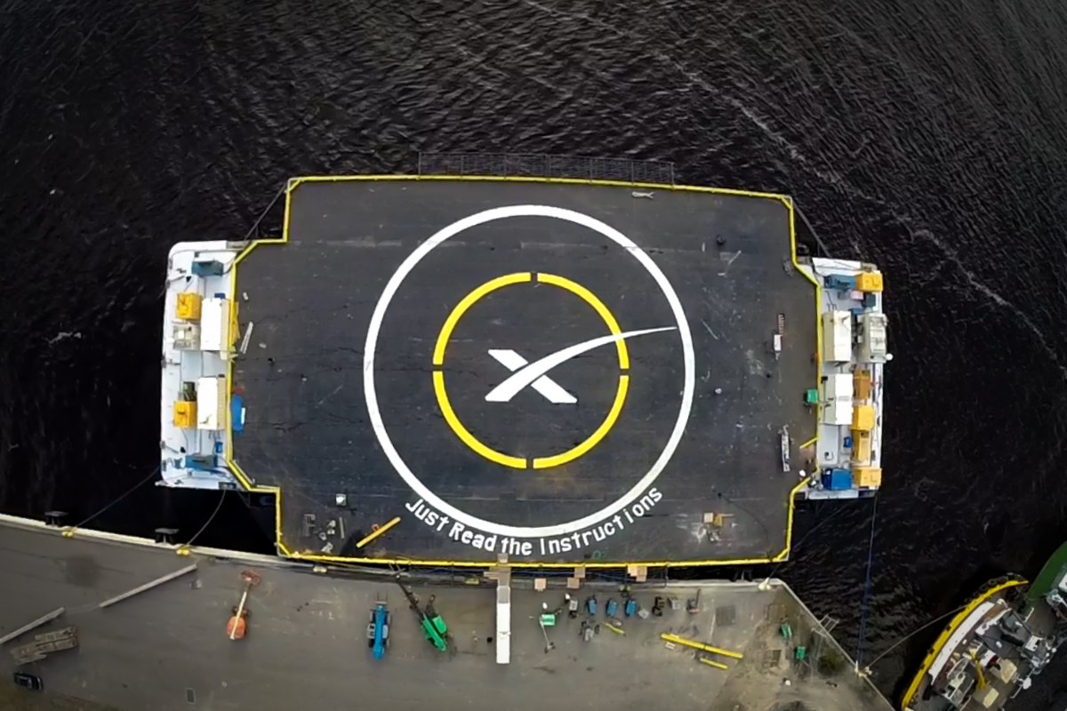
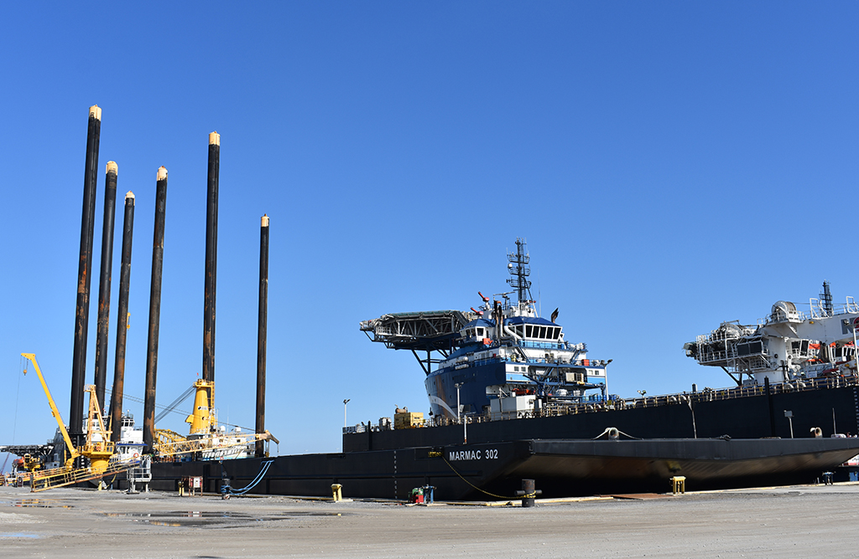
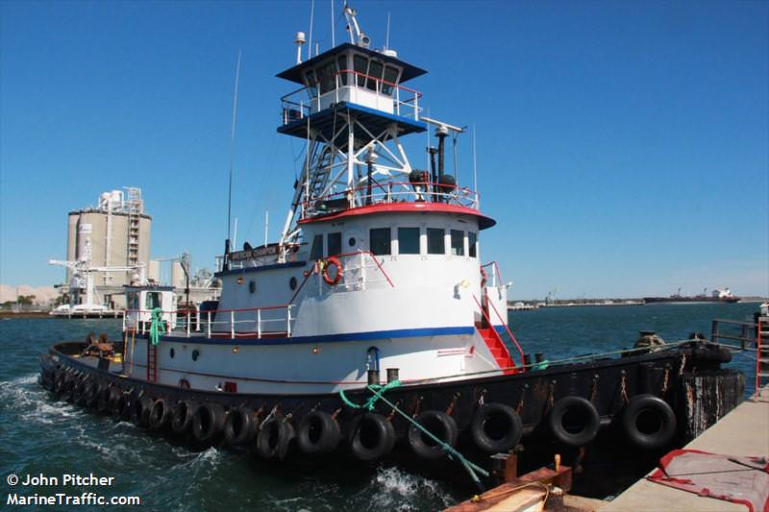
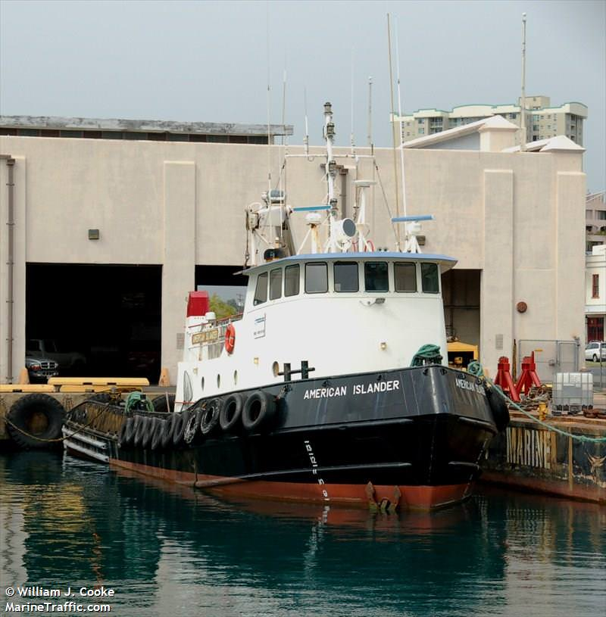
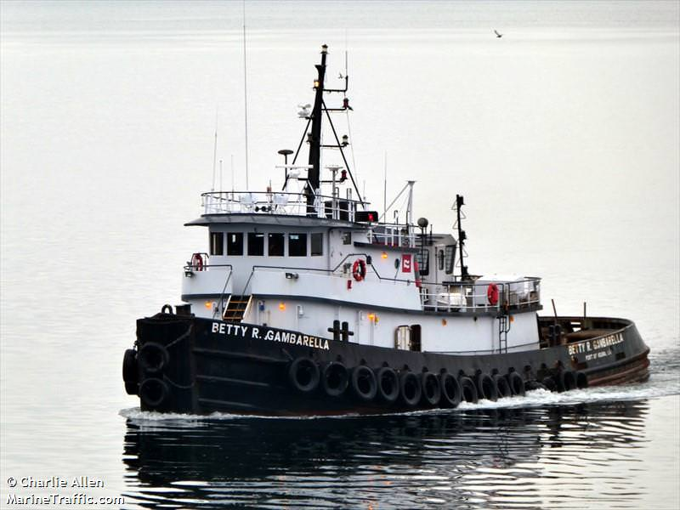
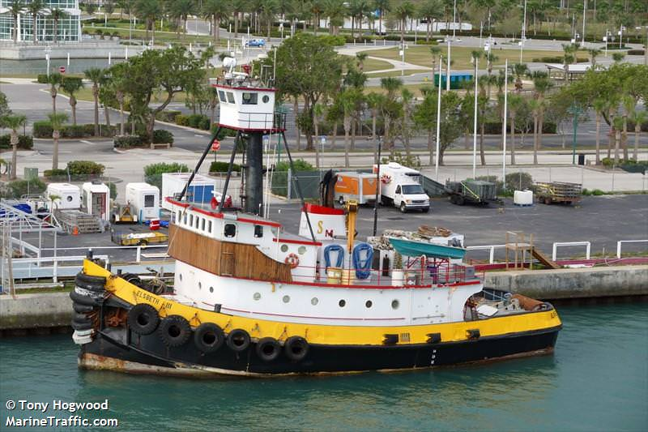
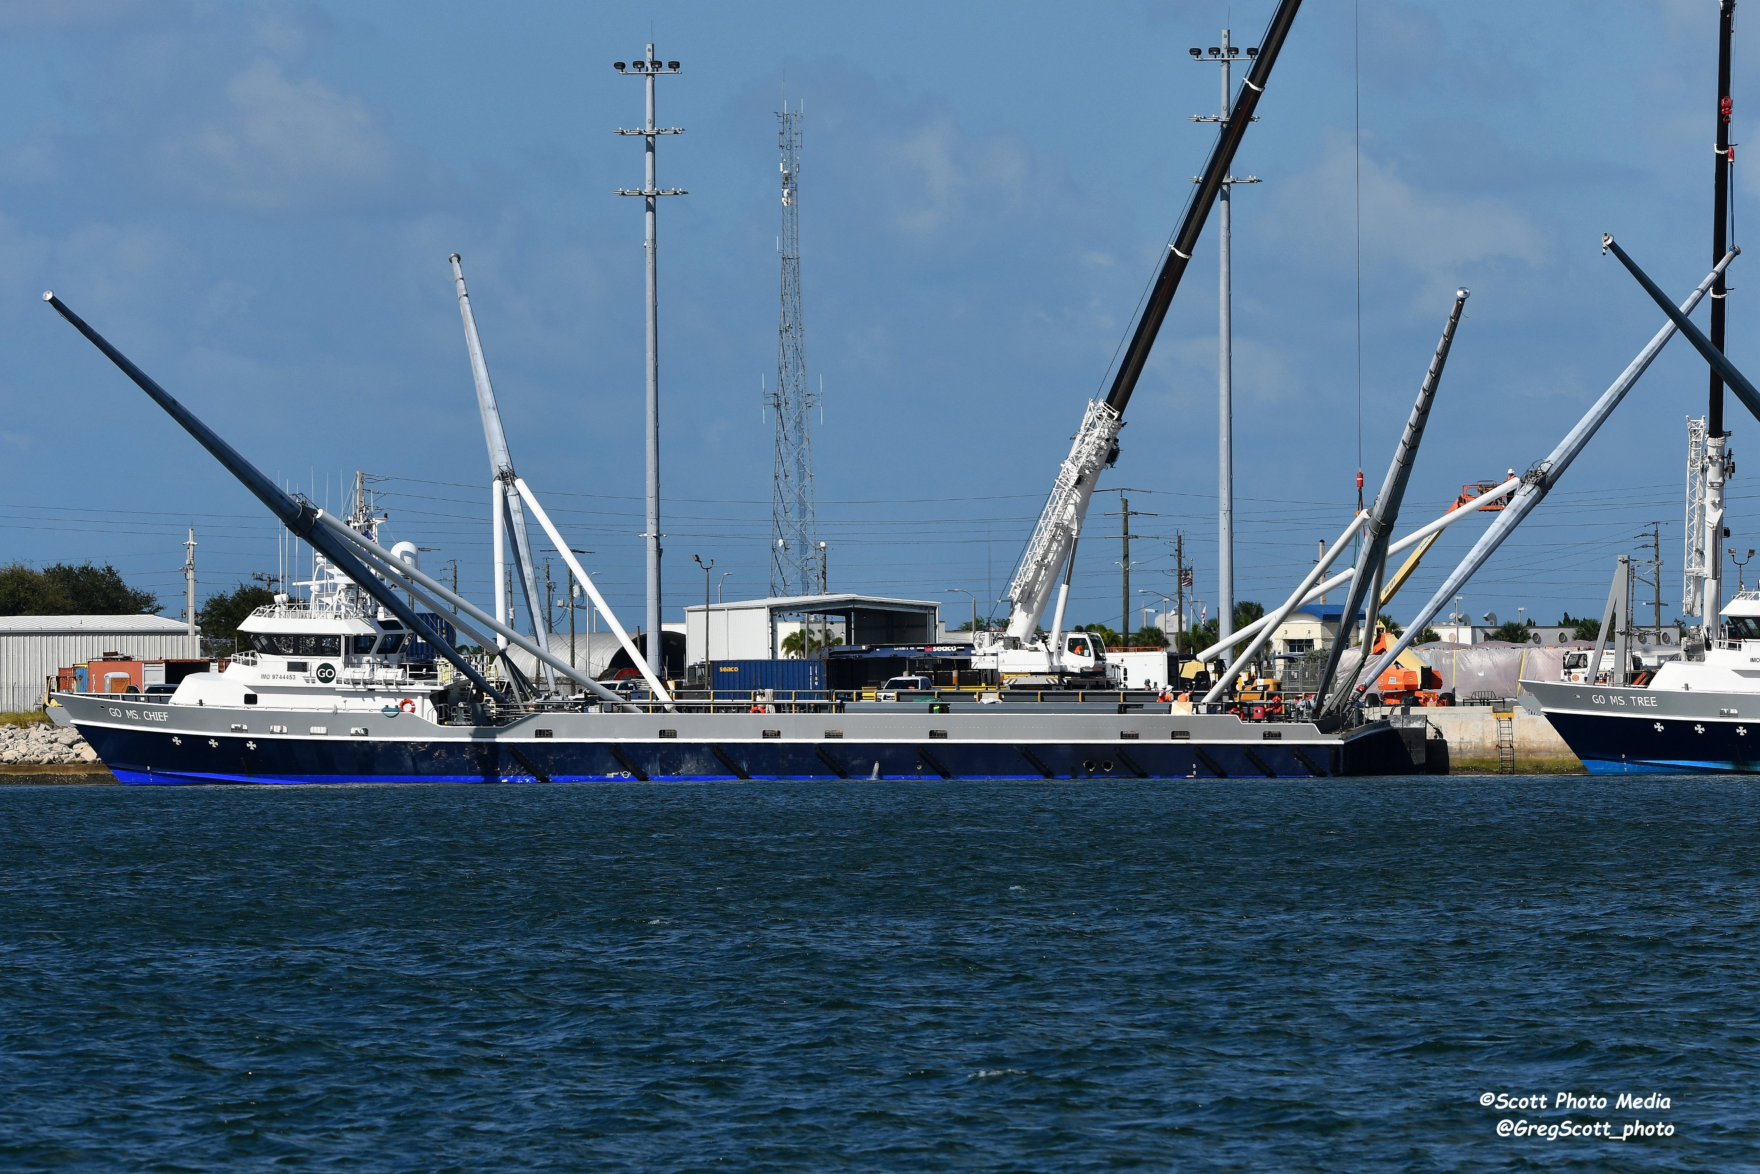
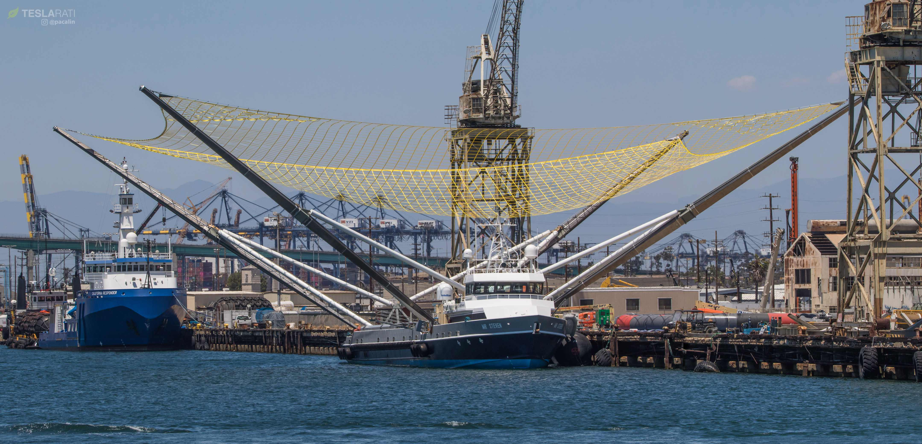
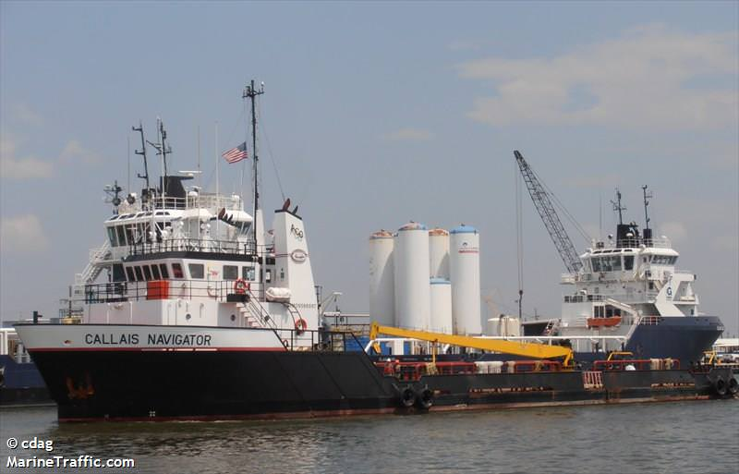
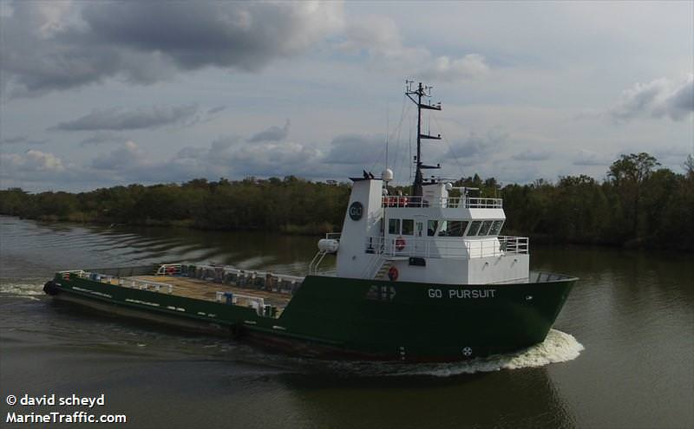
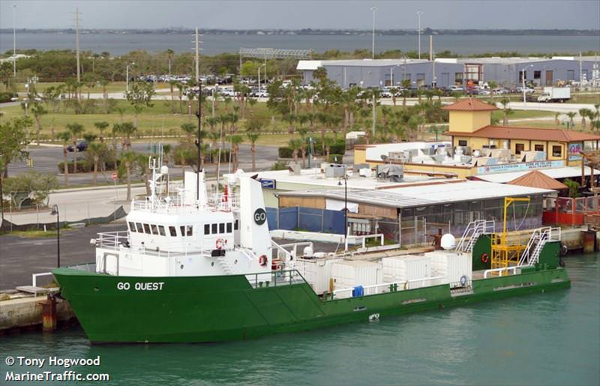
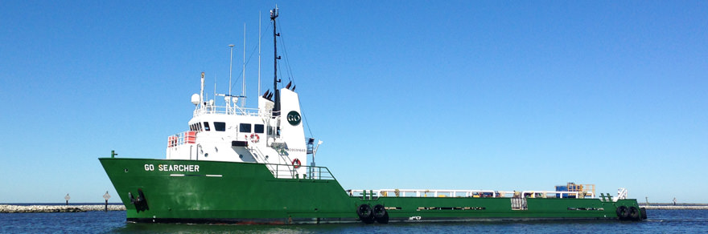
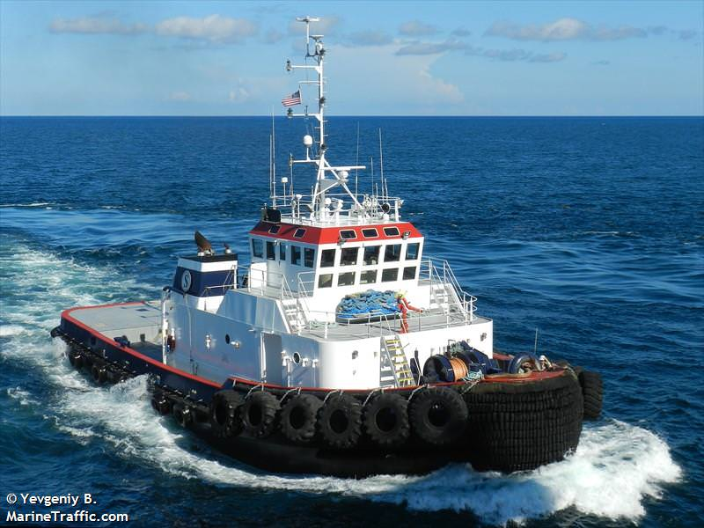
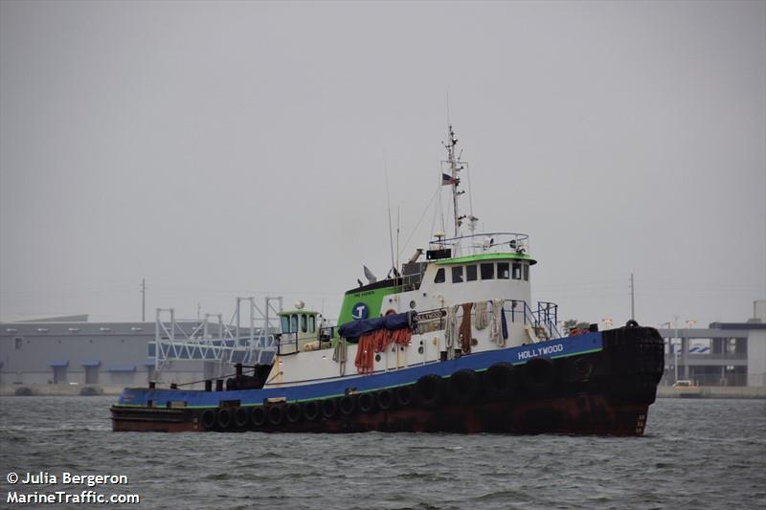
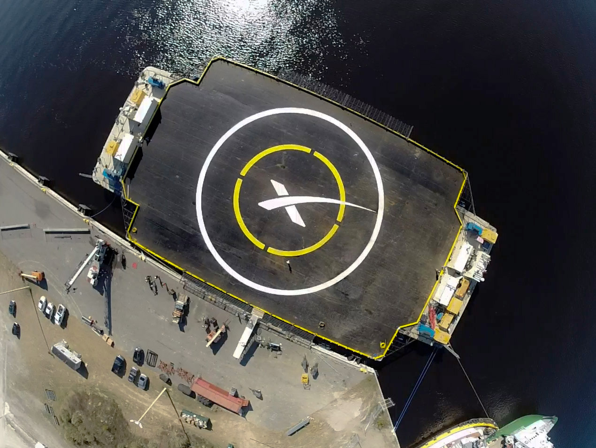
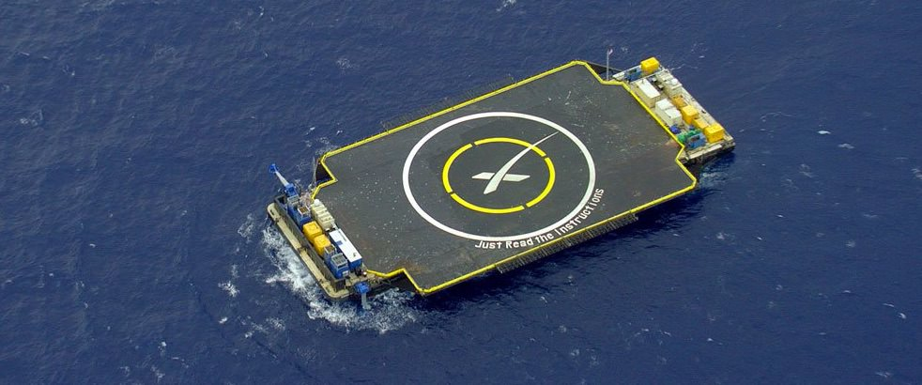
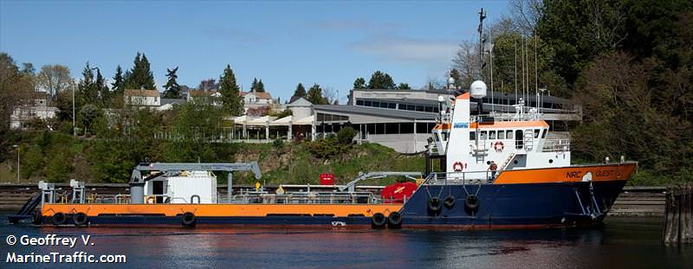
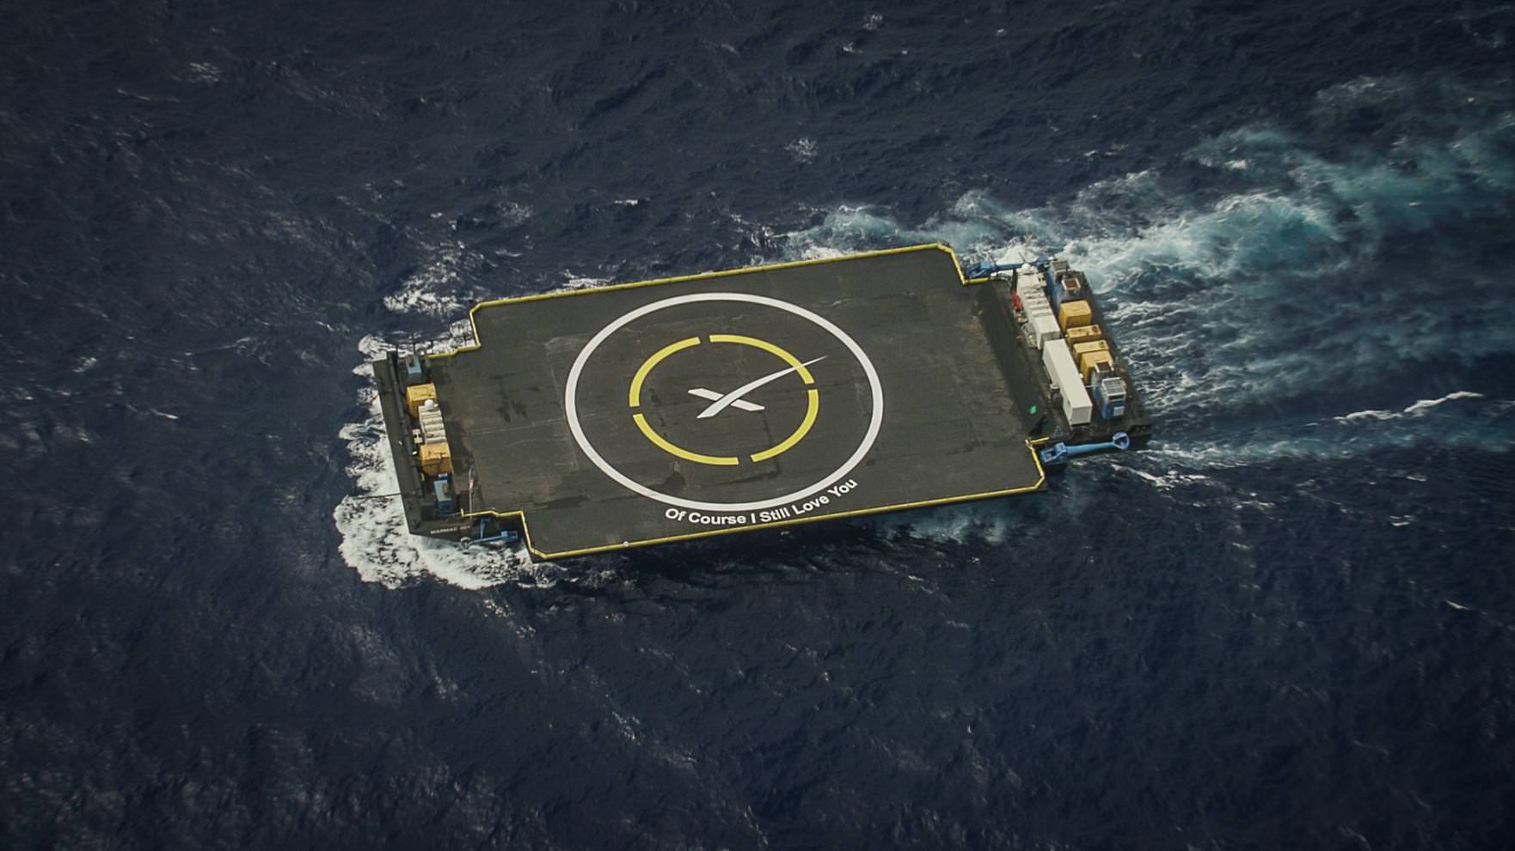
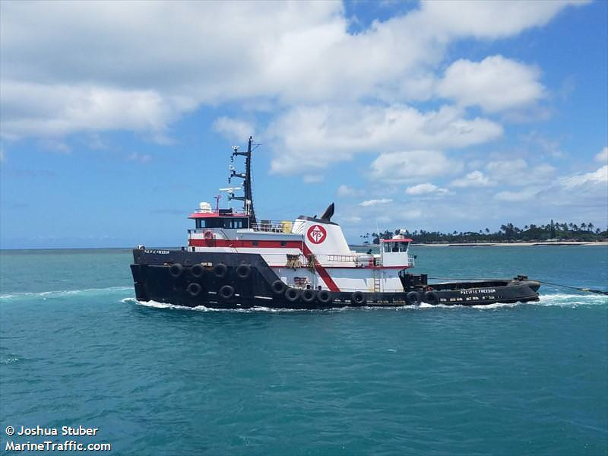
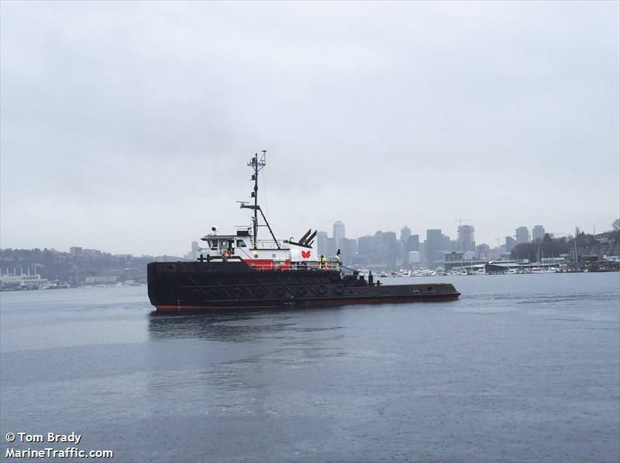
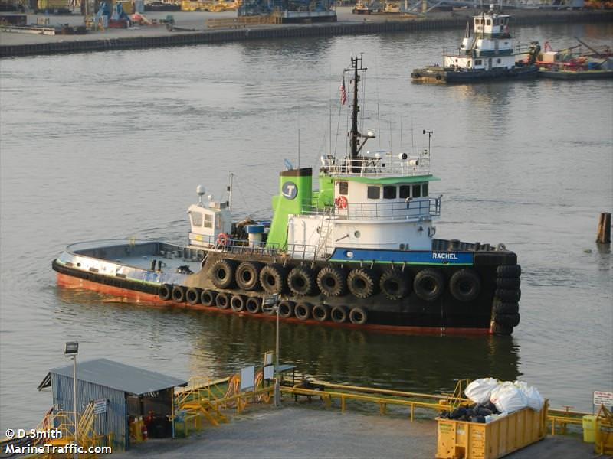
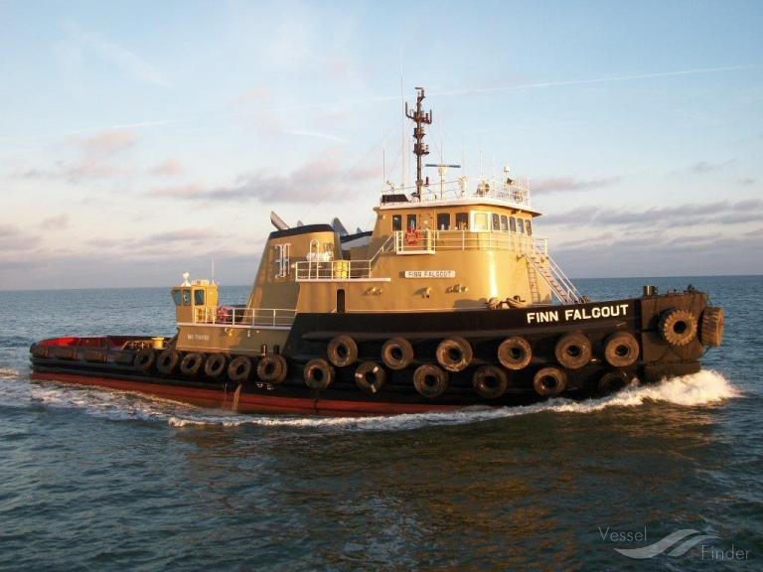
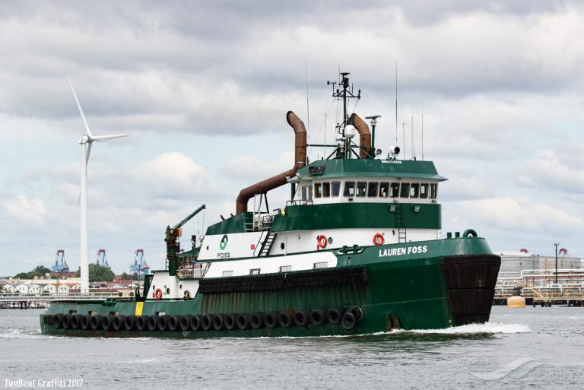
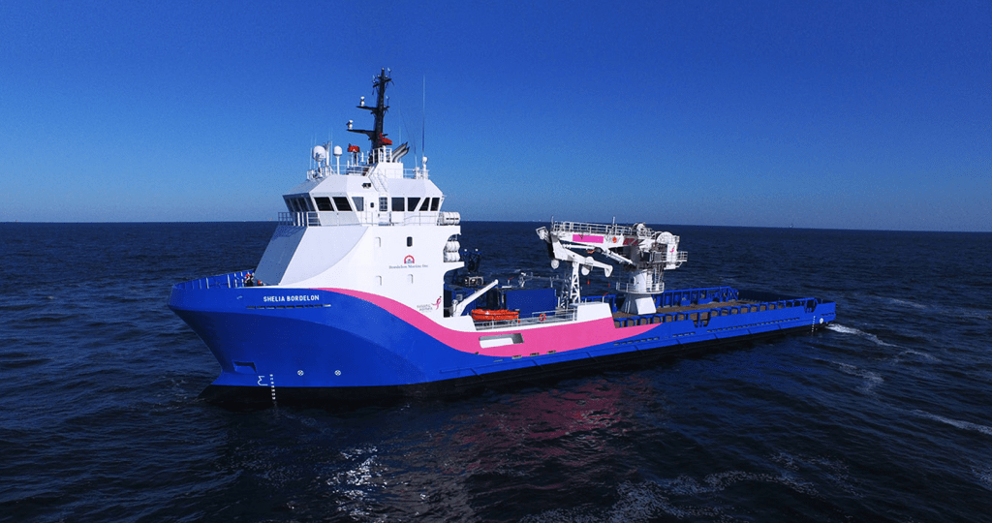
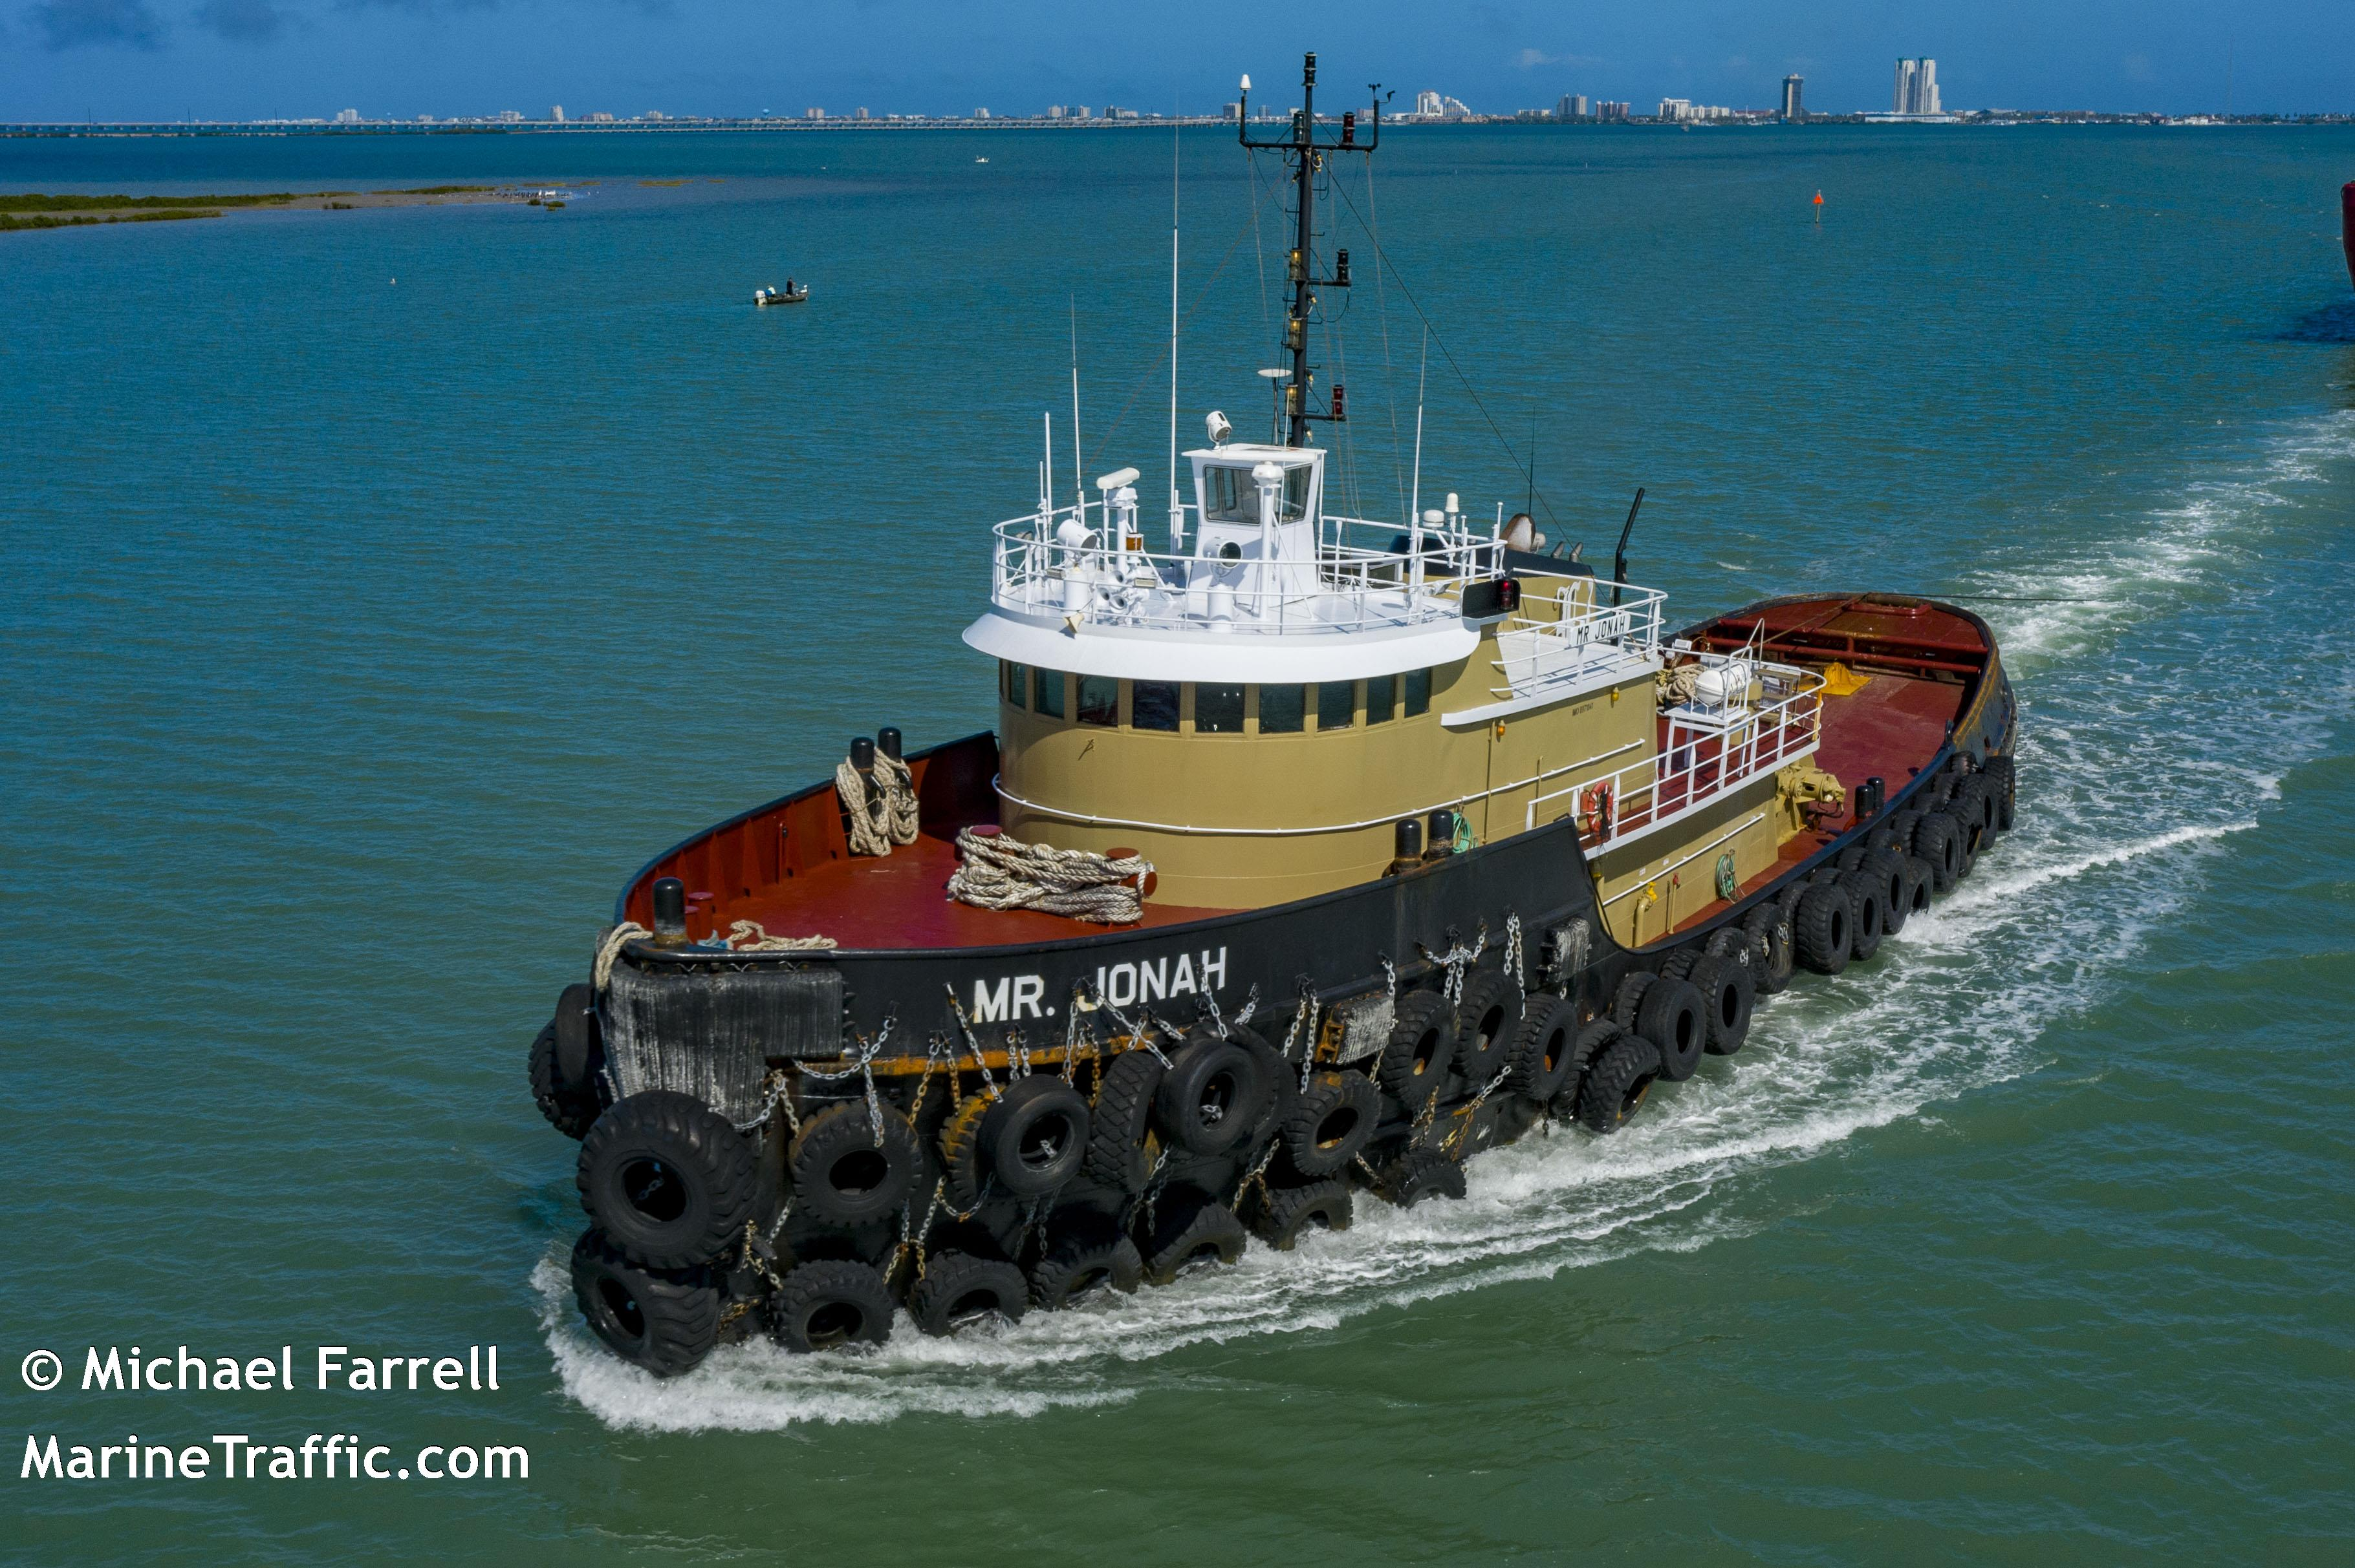
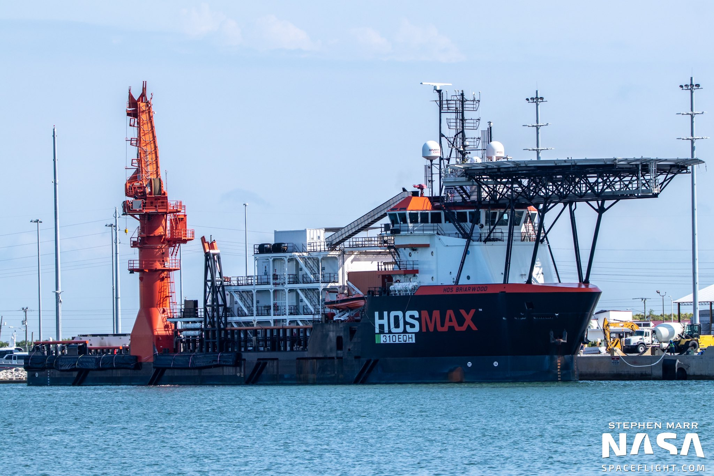
SpaceX
AOP Trial
Data source

Slide 2
About SpaceX
AOP Trial
Description: SpaceX designs, manufactures and launches advanced rockets and spacecraft. The company was founded in 2002 to revolutionize space technology, with the ultimate goal of enabling people to live on other planets.
Founder: Elon Musk
Founded: 2002
Employees: 7000
Valuation: $27500000000
Headquarters: Rocket Road, Hawthorne, California
Website

Slide 3
Rockets
AOP Trial
Data about the rockets built by SpaceX

Slide 4
Rocket: Falcon 1
AOP Trial
Height: 22.25 m
Diameter: 1.68 m
Mass: 30146 kg
First flight: 2006-03-24
Description: The Falcon 1 was an expendable launch system privately developed and manufactured by SpaceX during 2006-2009.
Wikipedia

Slide 5
Rocket: Falcon 9
AOP Trial
Height: 70 m
Diameter: 3.7 m
Mass: 549054 kg
First flight: 2010-06-04
Description: Falcon 9 is a two-stage rocket designed and manufactured by SpaceX for the reliable and safe transport of satellites and the Dragon spacecraft into orbit.
Wikipedia

Slide 6
Rocket: Falcon Heavy
AOP Trial
Height: 70 m
Diameter: 12.2 m
Mass: 1420788 kg
First flight: 2018-02-06
Description: With the ability to lift into orbit over 54 metric tons (119,000 lb)--a mass equivalent to a 737 jetliner loaded with passengers, crew, luggage and fuel--Falcon Heavy can lift more than twice the payload of the next closest operational vehicle, the Delta IV Heavy, at one-third the cost.
Wikipedia

Slide 7
Rocket: Starship
AOP Trial
Height: 118 m
Diameter: 9 m
Mass: 1335000 kg
First flight: 2021-12-01
Description: Starship and Super Heavy Rocket represent a fully reusable transportation system designed to service all Earth orbit needs as well as the Moon and Mars.
Wikipedia

Slide 8
Rockets: cost per launch
AOP Trial

Slide 9
Dragons
AOP Trial
Data about the dragon capsules of SpaceX

Slide 10
Dragon: Dragon 1
AOP Trial
Diameter: 3.7 m
Dry mass: 4200 kg
Description: Dragon is a reusable spacecraft developed by SpaceX, an American private space transportation company based in Hawthorne, California.
Wikipedia

Slide 11
Dragon: Dragon 2
AOP Trial
Diameter: 3.7 m
Dry mass: 6350 kg
Description: Dragon 2 (also Crew Dragon, Dragon V2, or formerly DragonRider) is the second version of the SpaceX Dragon spacecraft, which will be a human-rated vehicle.
Wikipedia

Slide 12
Launch pads
AOP Trial
Data about SpaceX's launch pads

Slide 13
Launch pad: VAFB SLC 3W
AOP Trial
Full name: Vandenberg Space Force Base Space Launch Complex 3W
Description: SpaceX's original west coast launch pad for Falcon 1.
Location: Vandenberg Space Force Base, California
Succeeded launch attempts: 0/0
Status: retired

Slide 14
Launch pad: CCSFS SLC 40
AOP Trial
Full name: Cape Canaveral Space Force Station Space Launch Complex 40
Description: SpaceX's primary Falcon 9 pad, where all east coast Falcon 9s launched prior to the AMOS-6 anomaly.
Location: Cape Canaveral, Florida
Succeeded launch attempts: 73/75
Status: active

Slide 15
Launch pad: STLS
AOP Trial
Full name: SpaceX South Texas Launch Site
Description: SpaceX's new private launch site currently under construction for suborbital test flights of Starship, and potentially orbital flights of the full super heavy stack (previously referred to as BFR) in the future.
Location: Boca Chica Village, Texas
Succeeded launch attempts: 0/0
Status: under construction

Slide 16
Launch pad: Kwajalein Atoll
AOP Trial
Full name: Kwajalein Atoll Omelek Island
Description: SpaceX's original pad, where all of the Falcon 1 flights occurred (from 2006 to 2009).
Location: Omelek Island, Marshall Islands
Succeeded launch attempts: 2/5
Status: retired

Slide 17
Launch pad: VAFB SLC 4E
AOP Trial
Full name: Vandenberg Space Force Base Space Launch Complex 4E
Description: SpaceX's primary west coast launch pad for polar orbits and sun-synchronous orbits, primarily used for Iridium NEXT and scientific satellite launches.
Location: Vandenberg Space Force Base, California
Succeeded launch attempts: 16/16
Status: active

Slide 18
Launch pad: KSC LC 39A
AOP Trial
Full name: Kennedy Space Center Historic Launch Complex 39A
Description: NASA's historic pad that launched most of the Saturn V and Space Shuttle missions, including Apollo 11.
Location: Cape Canaveral, Florida
Succeeded launch attempts: 36/36
Status: active

Slide 19
Landing pads
AOP Trial
Data about SpaceX's landing pads

Slide 20
Landing pad: LZ-1
AOP Trial
Full name: Landing Zone 1
Description: SpaceX's first east coast landing pad is Landing Zone 1, where the historic first Falcon 9 landing occurred in December 2015.
Type: RTLS
Location: Cape Canaveral, Florida
Succeeded landing attempts: 17/18
Status: active
Wikipedia

Slide 21
Landing pad: LZ-2
AOP Trial
Full name: Landing Zone 2
Description: SpaceX's first east coast landing pad is Landing Zone 1, where the historic first Falcon 9 landing occurred in December 2015.
Type: RTLS
Location: Cape Canaveral, Florida
Succeeded landing attempts: 3/3
Status: active
Wikipedia

Slide 22
Landing pad: LZ-4
AOP Trial
Full name: Landing Zone 4
Description: SpaceX's west coast landing pad.
Type: RTLS
Location: Vandenberg Air Force Base, California
Succeeded landing attempts: 3/3
Status: active
Wikipedia

Slide 23
Landing pad: OCISLY
AOP Trial
Full name: Of Course I Still Love You
Description: The second ASDS barge, Of Course I Still Love You (OCISLY), had been under construction in a Louisiana shipyard since early 2015 using a different hull—Marmac 304—in order to service launches on the east coast.
Type: ASDS
Location: Port Canaveral, Florida
Succeeded landing attempts: 46/53
Status: active
Wikipedia

Slide 24
Landing pad: JRTI-1
AOP Trial
Full name: Just Read The Instructions V1
Description: The ASDS landing location for the first landing test was in the Atlantic approximately 200 miles (320 km) northeast of the launch location at Cape Canaveral, and 165 miles (266 km) southeast of Charleston, South Carolina.
Type: ASDS
Location: Port Canaveral, Florida
Succeeded landing attempts: 0/2
Status: retired
Wikipedia

Slide 25
Landing pad: JRTI
AOP Trial
Full name: Just Read The Instructions
Description: The third ASDS barge, using the Marmac 303 hull, was built during 2015 in a Louisiana shipyard, and the barge transited the Panama Canal in June 2015 carrying its wing extensions as cargo on the deck because the ASDS, when complete, would be too wide to pass through the canal.
Type: ASDS
Location: Port of Los Angeles, California
Succeeded landing attempts: 20/21
Status: active
Wikipedia

Slide 26
Landing pad: ASOG
AOP Trial
Full name: A Shortfall of Gravitas
Description: The fourth ASDS barge was announced to be under construction in February 2018 and it will become the second active east coast-based ASDS.
Type: ASDS
Location: Port Canaveral, Florida
Succeeded landing attempts: 0/0
Status: under construction
Wikipedia

Slide 27
Ships
AOP Trial
Data about the ships that assist SpaceX launches, including ASDS drone ships, tugs, fairing recovery ships, and various support ships

Slide 28
Ship: American Champion
AOP Trial
Roles:
Support Ship
Barge Tug
Home port: Port of Los Angeles
Year built: 1976
Mass: 266712 kg
Website

Slide 29
Ship: American Islander
AOP Trial
Roles:
Dragon Recovery
Home port: Port of Los Angeles
Website

Slide 30
Ship: American Spirit
AOP Trial
Roles:
Support Ship
Home port: Port of Los Angeles

Slide 31
Ship: A Shortfall of Gravitas
AOP Trial
Roles:
ASDS barge
Home port: Port Canaveral

Slide 32
Ship: Betty R Gambarella
AOP Trial
Roles:
ASDS Tug
Home port: Port of Los Angeles
Year built: 1974
Mass: 202302 kg
Website

Slide 33
Ship: Elsbeth III
AOP Trial
Roles:
ASDS Tug
Home port: Port Canaveral
Year built: 1999
Mass: 273063 kg
Website

Slide 34
Ship: GO Ms Chief
AOP Trial
Roles:
Fairing Recovery
Home port: Port Canaveral
Year built: 2014
Mass: 449964 kg
Website

Slide 35
Ship: GO Ms Tree
AOP Trial
Roles:
Fairing Recovery
Home port: Port Canaveral
Year built: 2015
Mass: 449964 kg
Website

Slide 36
Ship: GO Navigator
AOP Trial
Roles:
Support Ship
Fairing Recovery
Home port: Port Canaveral
Year built: 2009
Mass: 451778 kg
Website

Slide 37
Ship: GO Pursuit
AOP Trial
Roles:
Support Ship
Fairing Recovery
Home port: Port Canaveral
Year built: 2007
Mass: 502999 kg
Website

Slide 38
Ship: GO Quest
AOP Trial
Roles:
Support Ship
Home port: Port Canaveral
Year built: 2014
Website

Slide 39
Ship: GO Searcher
AOP Trial
Roles:
Support Ship
Fairing Recovery
Home port: Port Canaveral
Year built: 2010
Mass: 450870 kg
Website

Slide 40
Ship: HAWK
AOP Trial
Roles:
ASDS Tug
Home port: Port Canaveral
Year built: 1995
Mass: 508023 kg
Website

Slide 41
Ship: Hollywood
AOP Trial
Roles:
ASDS Tug
Home port: Fort Lauderdale
Year built: 1985
Mass: 320236 kg
Website

Slide 42
Ship: Just Read The Instructions 1
AOP Trial
Roles:
ASDS barge
Home port: Port Canaveral
Year built: 2014

Slide 43
Ship: Just Read The Instructions 2
AOP Trial
Roles:
ASDS barge
Home port: Port Canaveral
Year built: 2015

Slide 44
Ship: Kelly C
AOP Trial
Roles:
ASDS Tug
Home port: Port of Los Angeles
Website

Slide 45
Ship: NRC Quest
AOP Trial
Roles:
Support Ship
Dragon Recovery
Home port: Port of Los Angeles
Year built: 2002
Mass: 440892 kg
Website

Slide 46
Ship: Of Course I Still Love You
AOP Trial
Roles:
ASDS barge
Home port: Port Canaveral
Year built: 2015

Slide 47
Ship: Pacific Freeedom
AOP Trial
Roles:
ASDS Tug
Home port: Port of Los Angeles
Year built: 1976
Mass: 89811 kg
Website

Slide 48
Ship: Pacific Warrior
AOP Trial
Roles:
ASDS Tug
Home port: Port of Los Angeles
Year built: 1974
Mass: 351080 kg
Website

Slide 49
Ship: RACHEL
AOP Trial
Roles:
ASDS Tug
Home port: Port Canaveral
Year built: 1976
Mass: 312072 kg
Website

Slide 50
Ship: Finn Falgout
AOP Trial
Roles:
Support Ship
Barge Tug
Home port: Port Canaveral
Year built: 1975
Mass: 843682 kg
Website

Slide 51
Ship: Lauren Foss
AOP Trial
Roles:
Support Ship
Barge Tug
Home port: Port Canaveral
Year built: 2003
Mass: 741170 kg
Website

Slide 52
Ship: Shelia Bordelon
AOP Trial
Roles:
Fairing Recovery
Support Ship
Home port: Port Canaveral
Year built: 2014
Mass: 2097411 kg
Website

Slide 53
Ship: Mr. Jonah
AOP Trial
Roles:
Support Ship
Barge Tug
Home port: Port Canaveral
Year built: 1944
Mass: 445428 kg
Website

Slide 54
Ship: HOS Briarwood
AOP Trial
Roles:
Fairing Recovery
Support Ship
Home port: Port Canaveral
Year built: 2015
Mass: 4616663 kg
Website

